Slide 1


INSTITUTE : UIE
DEPARTMENT : CSE
Bachelor of Engineering (Computer Science & Engineering)
WEB AND MOBILE SECURITY (Professional Elective-I)
(20CST/IT-333)
TOPIC OF PRESENTATION:
Mobile Security-Security of GSM Networks, Security of UMTS Networks
DISCOVER . LEARN . EMPOWER

Slide 2
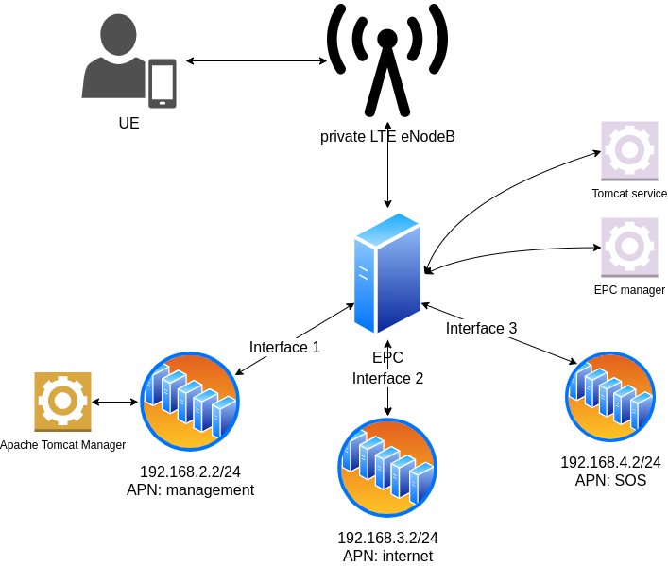
Lecture Objectives
In this lecture, we will discuss:
Mobile Security-Security of GSM Networks, Security of UMTS and LTE Networks

Slide 3
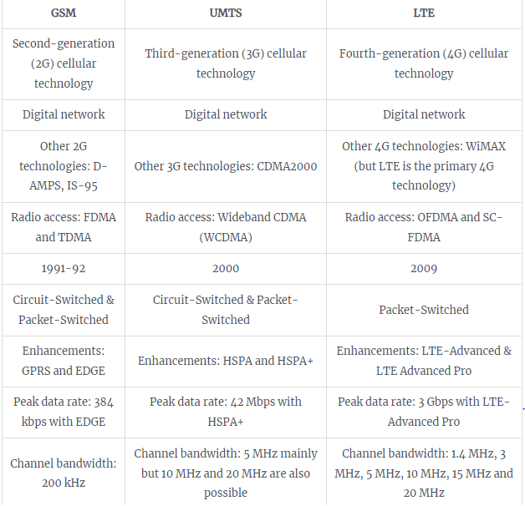
Difference Between GSM, UMTS And LTE?
https://commsbrief.com/difference-between-gsm-umts-lte/

Slide 4
GSM
The GSM(Global System for Mobile Communications) network is divided in 4 sections :
• Mobile Stations The subscriber will use a mobile station to make and receive calls via the GSM network. The MS is composed of two distinct functional entities, the subscriber identity module (SIM), which is a removable smart card, and the mobile equipment.
• Base Station Subsystem (BSS) The MS communicates with the base transceiver station (BTS) via the radio interference. A BTS performs all the transmission and reception functions relating to the GSM.
• Network Management Every BSS is connected to a Mobile services switching centre (MSC). The MSC is concerned with the routing of calls to and from the mobile users. The Home Location register (HLR) is used to store information that is specific to each subscriber. Every GSM subscriber will have a record in the HLR.

Slide 5
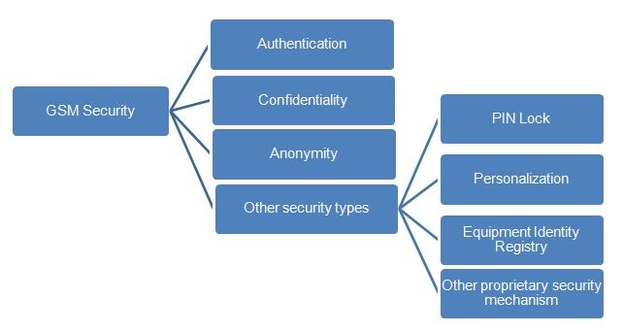
GSM security covers:

Slide 6
Authentication process helps gsm network authenticate the right user. This process is based on exchanged secret key Ki which is known to AuC (Authentication Center) and SIM card. there is no provision to read the key Ki from the SIM.
Anonymity: Here IMSI(international mobile Subscriber identity) is associated with a unique user (SIM), after the initial registration, a TMSI is assigned to the subscriber. The TMSI(Temporary mobile Subscriber identity) is stored along with the IMSI in the network HLR.
The second important concept in gsm security is identity confidentiality. This protects user from any intrusion. This is provided to the gsm subscriber using TMSI (temporary mobile subscriber identity).
In gsm, message and/or data ciphering is carried using A5 algorithm using the key Kc. PIN lock is the feature by which user can protect usage of the SIM card by any unauthorized person. With personalization user can make Mobile Equipment work only with his SIM card. Hence ME can be protected.

Slide 7
Algorithms
Encryption algorithms GSM algorithms were developed in secret, official descriptions were not published to the public. Most of the information available come from leaked documents and cryptanalysis projects. GSM specifications define 3 algorithms:
A3 the authentication algorithm.
A8 the key generation algorithm.
A5 the encryption algorithm.
https://web.itu.edu.tr/~korkusuza/Security%20in%20the%20GSM%20Network.pdf?kategori=php

Slide 8
UMTS(Universal Mobile Telecommunication System) network
UMTS is designed to interoperate with GSM networks. To protect GSM networks against man-in-middle attacks, 3GPP is considering to add a structure RAND authentication challenge.
Five security groups exist in UMTS networks as shown in the figure. • Network Access Security • Network domain security • User domain security • Application domain security • visibility, configurability of security
https://www.rfwireless-world.com/Tutorials/3G-security.html

Slide 9
UMTS Security
The security functions of UMTS are based on what was implemented in GSM. Some of the security functions have been added and some existing have been improved. Encryption algorithm is stronger and included in base station (NODE-B) to radio network controller (RNC) interface , the application of authentication algorithms is stricter and subscriber confidentially is tighter. The main security elements that are from GSM:
Authentication of subscribers
Subscriber identity confidentially
Subscriber Identity Module (SIM) to be removable from terminal hardware.
Radio interface encryption
Additional UMTS security features:
Security against using false base stations with mutual authentication
Encryption extended from air interface only to include Node-B to RNC connection
Security data in the network will be protected in data storages and while transmitting ciphering keys and authentication data in the system.
Mechanism for upgrading security features.
https://www.umtsworld.com/technology/security.htm

Slide 10
References:
Books:
Hacking Exposed Mobile: Security Secrets & Solutions 1st Edition, Kindle Edition, by Neil Bergman, Mike Stanfield, Jason Rouse, and Joel Scambray
Hacking Exposed Web Applications, 3rd edition, Joel Scambray, Vincent Liu, Caleb Sima, Released October 2010, Publisher(s): McGraw-Hill
Reference Links:
https://www.cse.iitb.ac.in/~vishalprajapati08/Study/CS649/GSM%20and%20UMTS%20Security%20Report.pdf
https://www.tutorialspoint.com/umts/umts_authentication.htm
https://www.geeksforgeeks.org/difference-between-umts-and-gsm/
https://www.umtsworld.com/technology/security.htm
Relevant Videos:
https://www.youtube.com/watch?v=WqBR6jd0IbU
https://www.youtube.com/watch?v=LLq1WnY1GjQ

Slide 11

THANK YOU

